Slide 1

Duration: 120 min
Chungnam University
Graduate class
Remote Sensing
Cleaning and formatting data
September 17th 2025
The focus is on data cleaning and formatting:
How to remove unwanted noise.
How to convert documents into usable formats.
How to structure them into instruction–answer pairs.
Why we need replay sets to avoid catastrophic forgetting in future fine-tunes.

Slide 2
Objective
When building AI assistants or fine-tuning models, raw documents are not directly usable. They contain:
Noise (headers, footers, page numbers, references).
Formatting issues (line breaks, hyphenation, strange encodings).
Unstructured text (not in Q–A format).
Goal this week: Learn how to transform messy documents into clean, structured and chunked.

Slide 3
Why Data Cleaning is Critical
Garbage in, garbage out: If the input dataset contains messy content, the model will learn mistakes.
Efficiency: Cleaned data reduces wasted GPU/CPU cycles during training.
Consistency: A consistent format ensures the model generalizes better.
Examples of bad training data:
PDF headers repeating on every page.
Footnotes or citations in wrong places.
Page numbers breaking sentences.
Mixed encodings (some UTF-8, some Latin-1).
Scanned OCR text with misread letters.
Example:
Raw text from a PDF:
Page 12 - Journal of Remote Sensing - 2022 Geo- logy is the study of Earth materials.
After cleaning:
Geology is the study of Earth materials.

Slide 4
Common Issues in Raw Documents
When you download documents (PDFs, DOCX, scraped HTML), you often see:
Headers – “Journal of Geology, Vol. 12” repeated on each page.
Footers – copyright, author info, references scattered.
Page numbers – “Page 21” in the middle of text.
Line breaks – sentences split because of PDF formatting.
Hyphenation – “geo-\nlogy” instead of “geology”.
Mixed encodings – unreadable characters (e.g., “â€”” instead of “—”).
If we feed these directly into training → model learns to generate garbage.
If these artifacts remain:
The model may learn to output “Page 12” in the middle of answers.
It wastes training steps memorizing irrelevant text.
Inconsistent formats lower generalization ability.
→ Rule: Clean and normalize everything before training.

Slide 5
RAW docs
Extract
Clean and format
Chunk
Add Metadata
Build Instruction-answer (I-A)
Split
Replay Set
Training-ready data

Slide 6
Raw Documents Extraction (.pdf, .docx, …)
Input: PDFs, DOCX, HTML
Actions: Convert to plain text (preserve paragraph breaks), export tables separately (CSV) if you’ll use them.
Output: extracted_text.txt, optional table_*.csv

Slide 7
Raw Documents Extraction (.pdf, .docx, …)
# Step 1: Extract text from a PDF
import PyPDF2
# Path to your PDF file
pdf_path = r"D:\Hoa_teaching_graduate_classes\example.pdf"
# Output file to save extracted text
output_path = r"D:\Hoa_teaching_graduate_classes\example_extracted.txt"
def extract_text_from_pdf(pdf_file, output_file):
# Open the PDF in read-binary mode
with open(pdf_file, "rb") as file:
reader = PyPDF2.PdfReader(file)
print(f"Total pages: {len(reader.pages)}")
all_text = ""
for page_num in range(len(reader.pages)):
page = reader.pages[page_num]
text = page.extract_text() or "" # extract_text() may return None
all_text += f"\n--- Page {page_num+1} ---\n"
all_text += text.strip() + "\n"
# Save extracted text to a .txt file
with open(output_file, "w", encoding="utf-8") as out_file:
out_file.write(all_text)
print(f"Extraction complete! Text saved to: {output_file}")
# Run the function
extract_text_from_pdf(pdf_path, output_path)

Slide 8
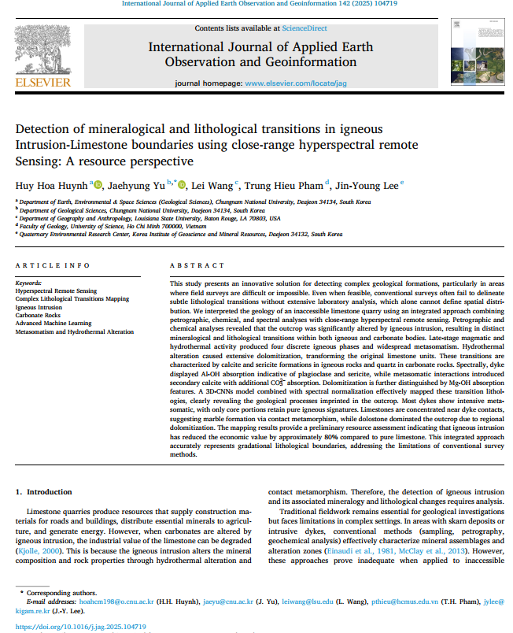
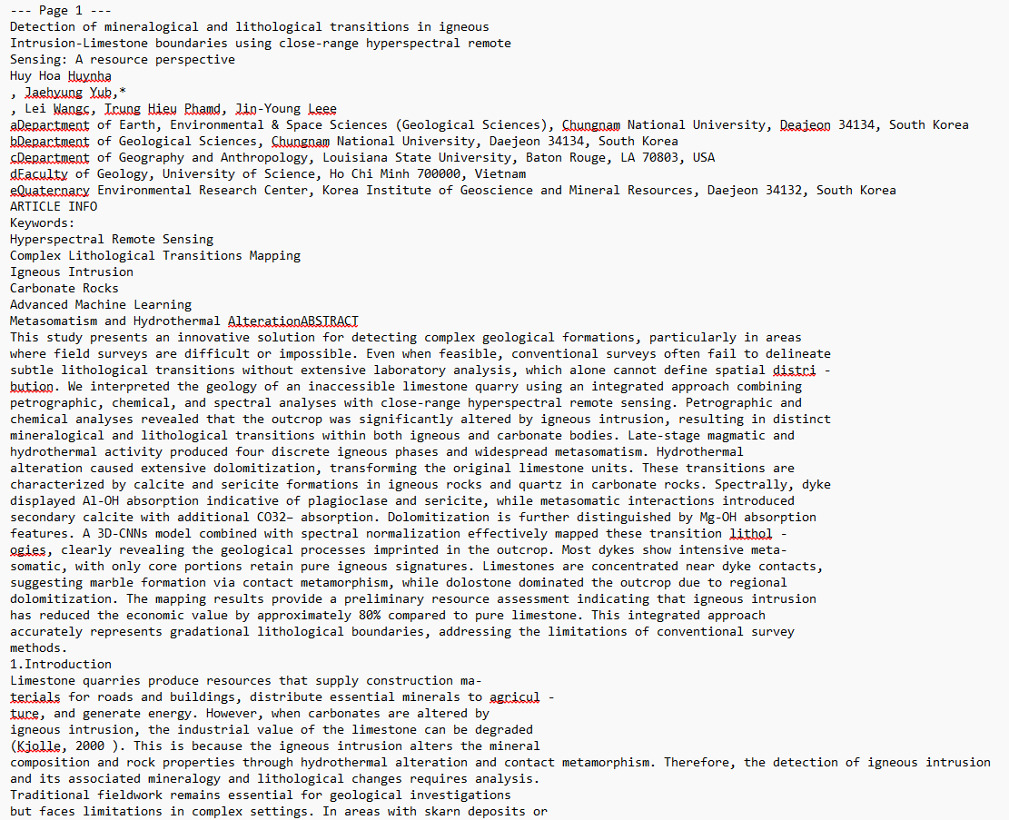
Raw Documents Extraction (.pdf, .docx, …)

Slide 9
Cleaning and formatting
Goal: Remove non-content noise that confuses models.
Actions:
drop headers/footers, page numbers, watermarks
fix hyphenated line breaks (geo-\nlogy → geology) & soft hyphens (U+00AD)
remove figure tokens (Fig. 3); optionally keep captions as text
standardize symbols/units (CO3^2−, 2340 nm, %)
(optional) strip inline citations (Author, 2024) if you want self-contained passages
Output: cleaned_text.txt

Slide 10
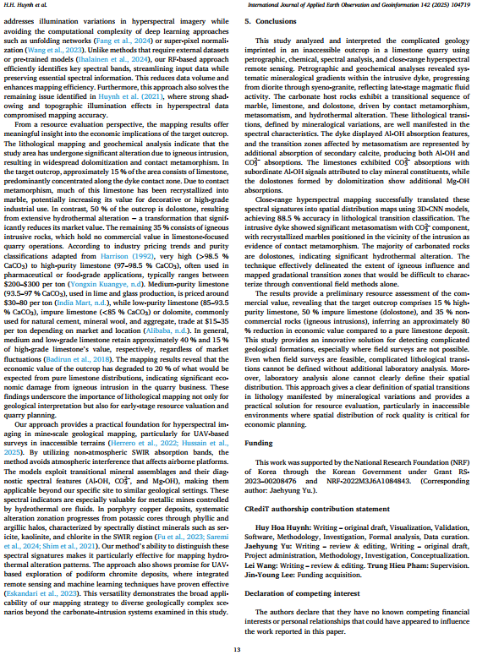
A) Front-matter & journal scaffolding (drop entirely)
Why: Not instructional content; creates noise in training examples.
Full affiliations and postal addresses
“A R T I C L E I N F O / A B S T R A C T” block styling
“Contents lists available at ScienceDirect”, journal homepage
DOI line, received/accepted/online dates
License text (e.g., CC BY sentence)
Page headers/footers like: H.H. Huynh et al. International Journal of Applied Earth Observation and Geoinformation 142 (2025) 104719
Inline page counters like … 2Fig. 1 / … 3.2.3. artefacts

Slide 11
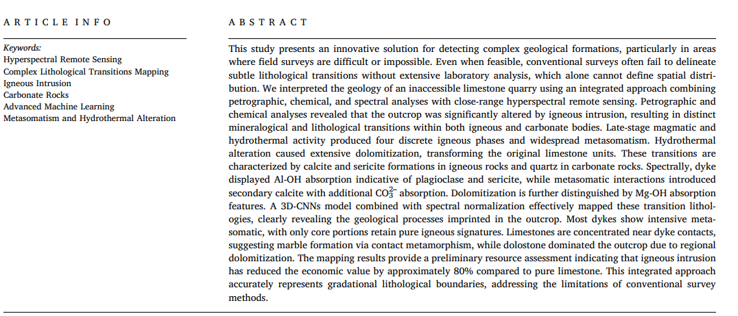
After:
hyperspectral remote sensing
lithological transitions
igneous intrusion
carbonate rocks
machine learning (RF, 3D-CNN)
metasomatism; hydrothermal alteration

Slide 12
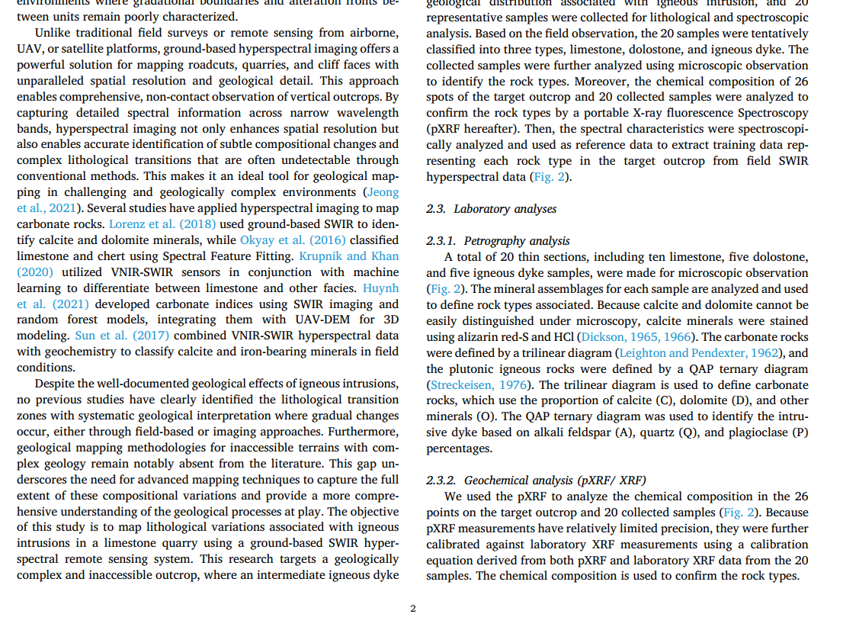
Citation style (strip or move)
Why: Parenthetical citations break QA tasks if the passage should be self-contained.
Remove (Author, Year) in the body used for I-A pairs
Optionally collect them into a “Further reading” note outside the input text
Before: … zones (Einaudi et al., 1981, McClay et al., 2013). After (training input): … zones.

Slide 13
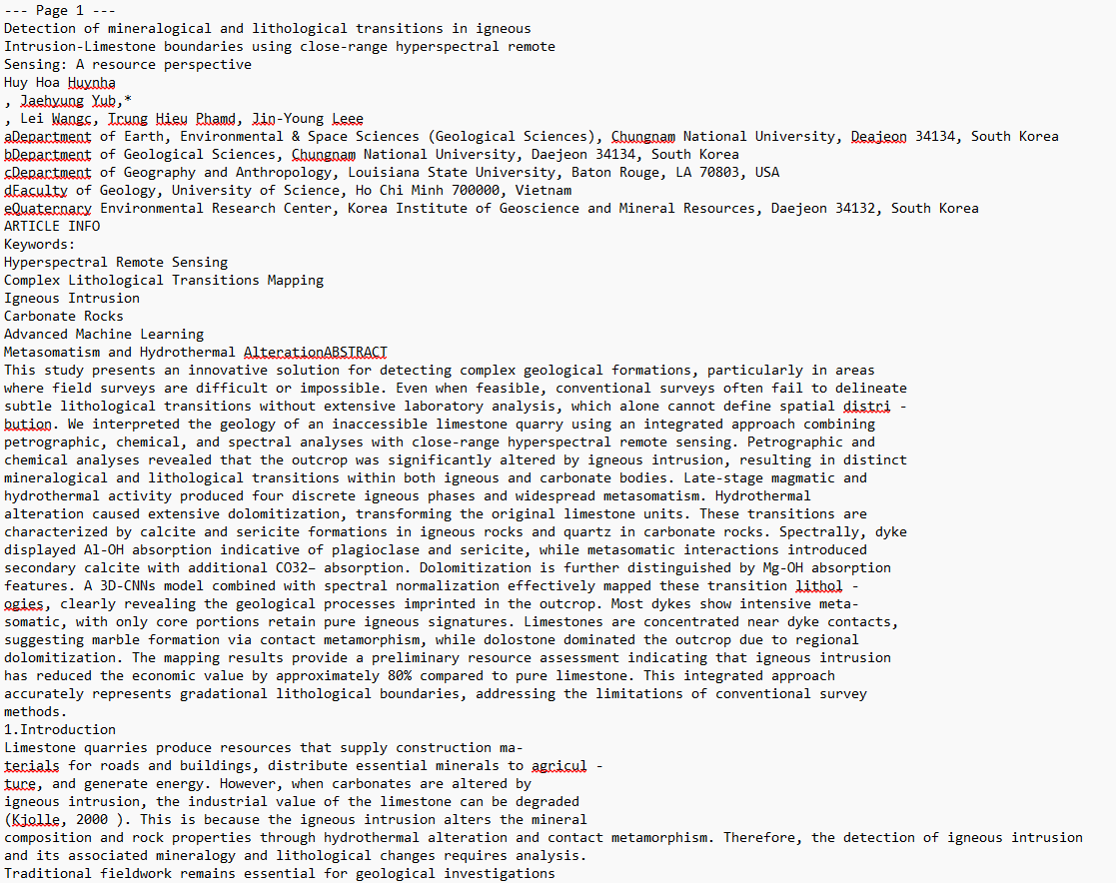

Slide 14
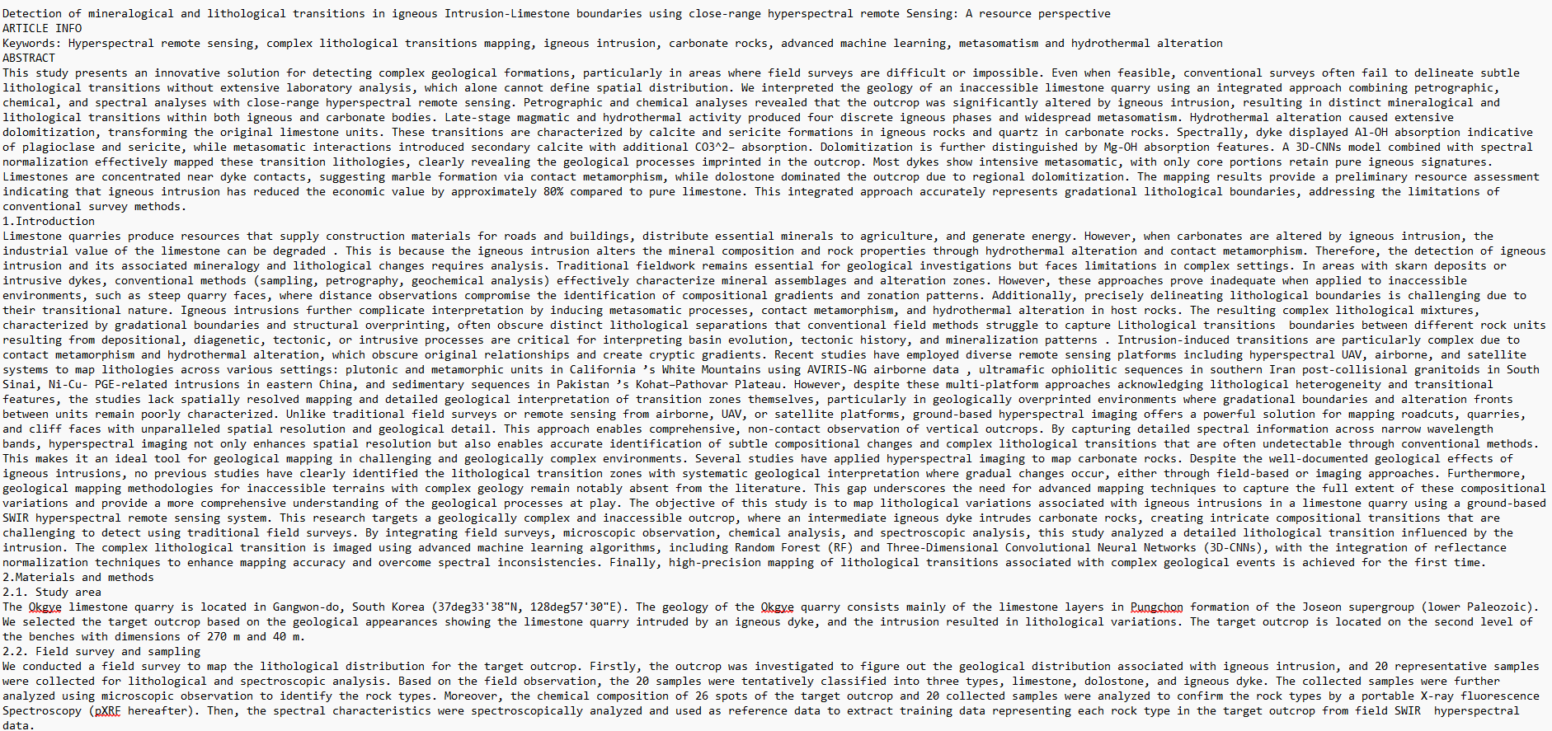

Slide 15
Cleaning and formatting
Chemical / ions
CO32- → CO3^2-
Fe2+ → Fe^2+
SO42- → SO4^2-
So the caret ^ marks superscripts (charge, isotope, etc.).
Coordinates
(37•33′38″N, 128•57′30″E) → (37deg33'38"N, 128deg57'30"E) (ASCII safe: deg instead of °).
Units
μm → um
°C → degC
‰ (per mil) → permil

Slide 16
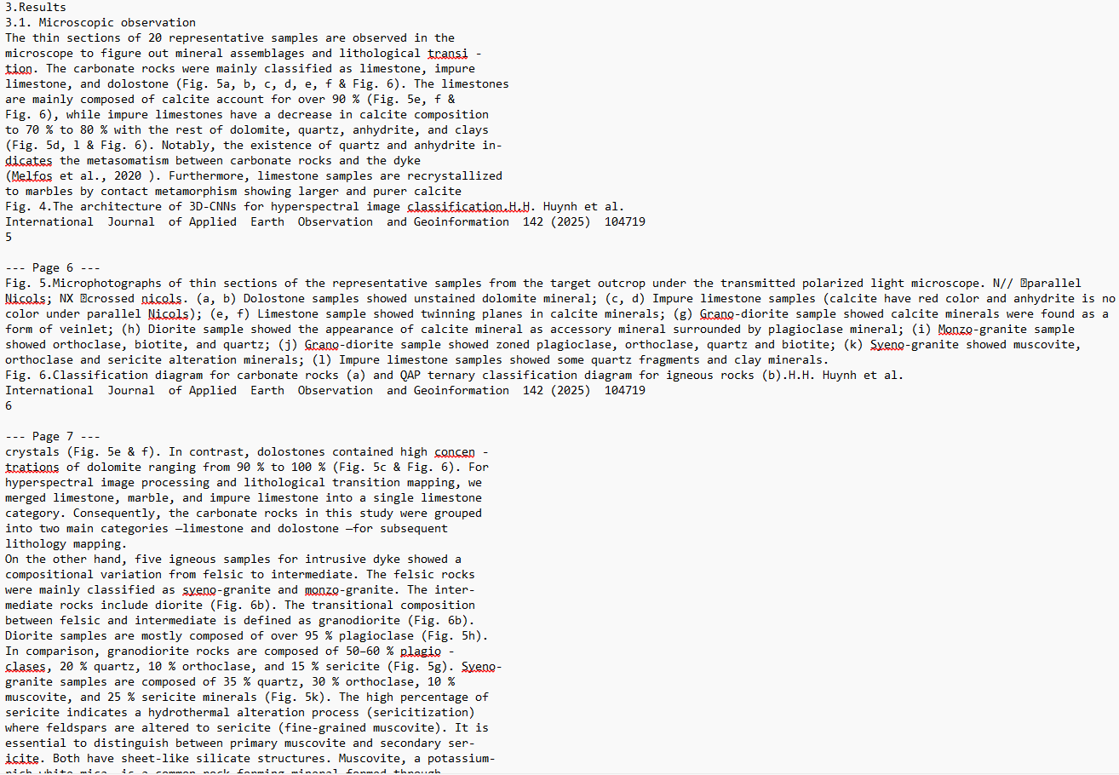

Slide 17
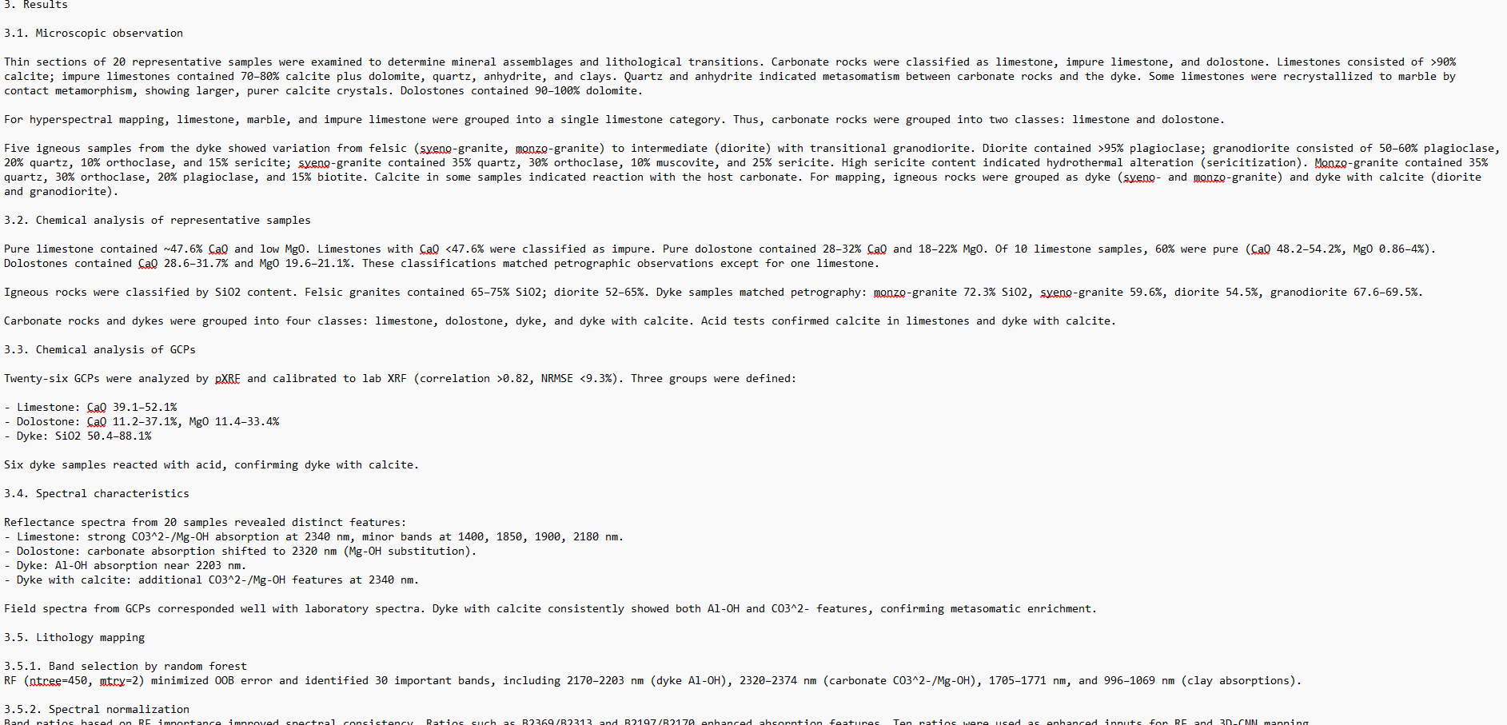

Slide 18
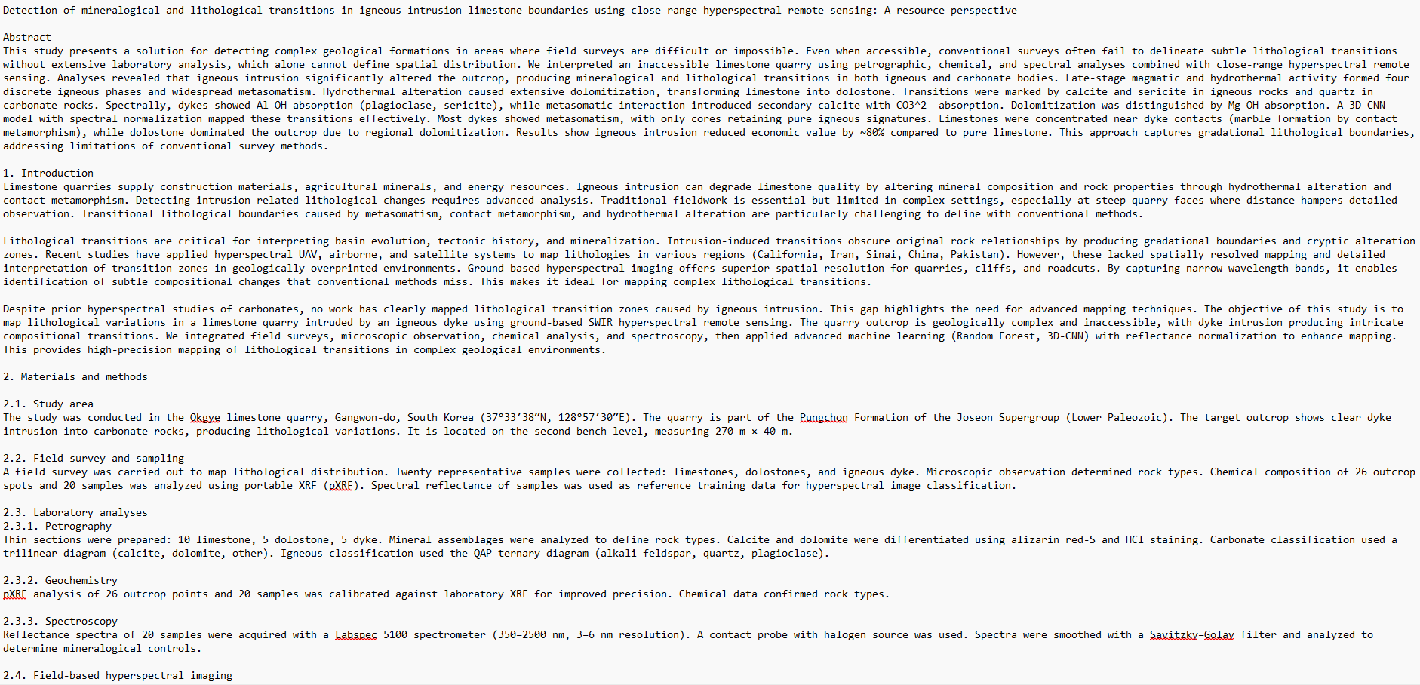

Slide 19
Chunking
Why: LLMs (even fine-tuned ones) can’t process entire papers/books at once. They work best on smaller, coherent chunks.
What we do:
Split long text into paragraphs or sections (e.g., ~200–500 tokens each).
Preserve meaning: don’t cut in the middle of a formula or sentence.
Add context metadata for each chunk:
Example: { "source": "Huynh2025", "topic": "dolostone classification", "chunk_id": 3 }.
Sometimes overlap chunks slightly (like a sliding window), so context isn’t lost between chunks.
→ Goal: make sure each training example is digestible for the model while still retaining geological meaning.

Slide 20
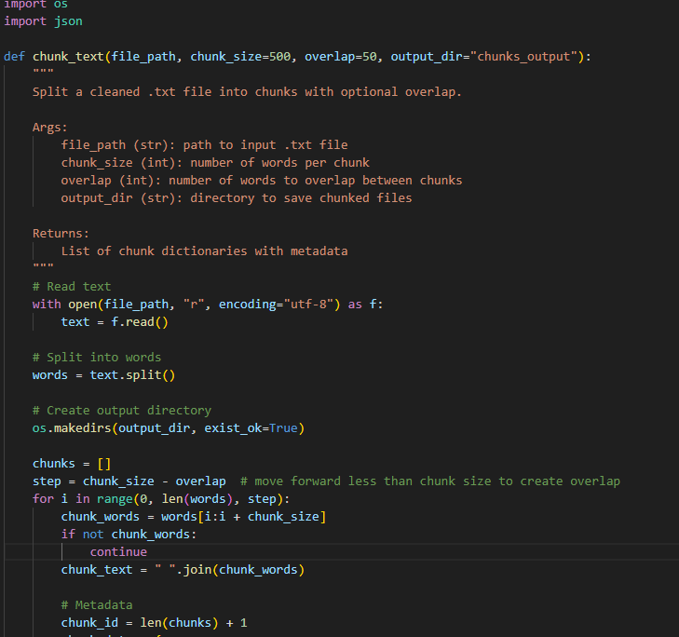
Chunking
Token limits of the model
LLMs don’t read words, they read tokens.
Roughly:
1 token ≈ 0.75 words (English scientific text).
So 300 words ≈ ~400 tokens.
If your target model has a context length of 4k tokens (like LLaMA-3 8B or Mistral 7B), safe chunk size is ~300–500 words.
If the model has 32k or 100k tokens, you can go bigger (1k–2k words per chunk).
Why overlap matters:
When you split a long document into chunks, you risk cutting an important sentence or idea in the middle.
If there’s no overlap, the model might lose context when moving from one chunk to the next.
Overlap makes sure the “boundary words” are included in both chunks, so important connections (like definitions, equations, references) aren’t lost.

Slide 21
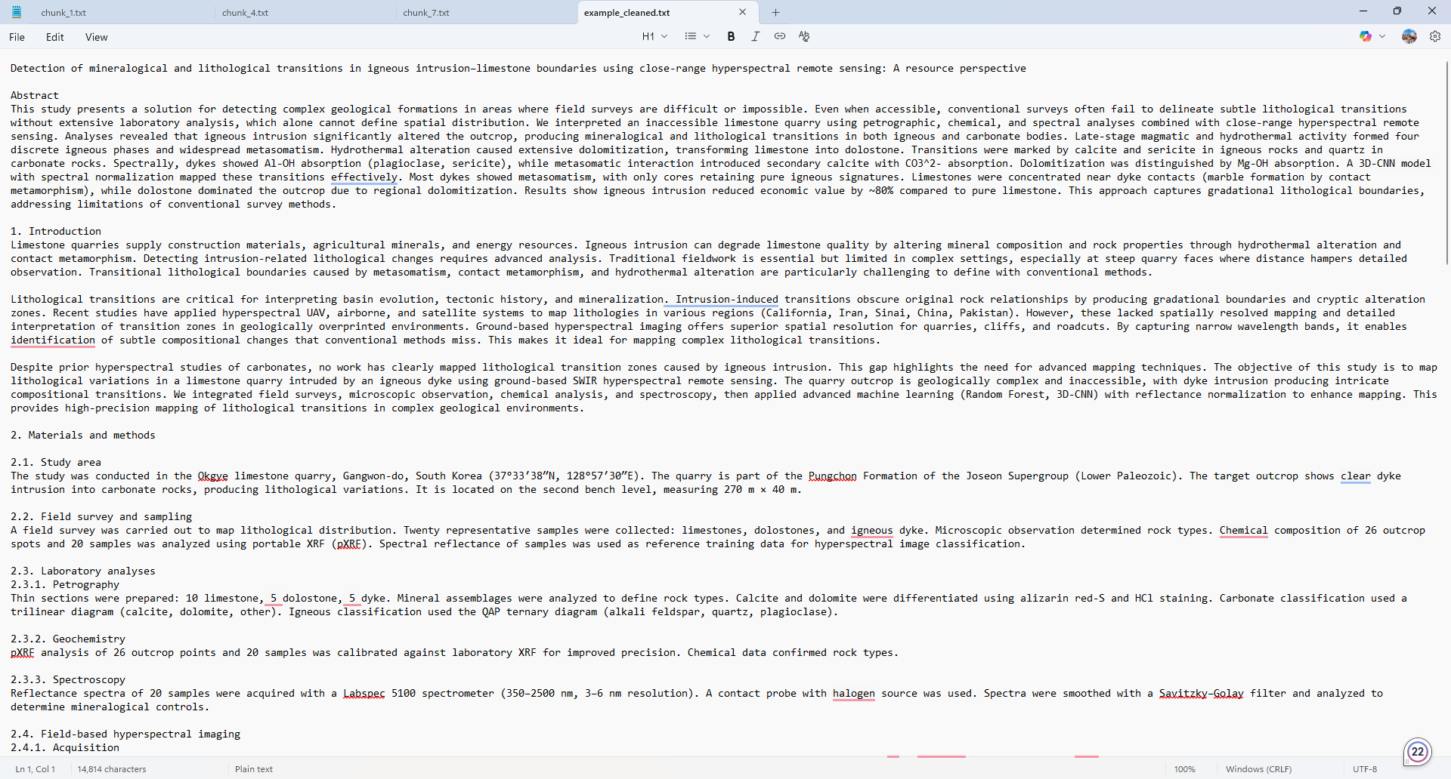
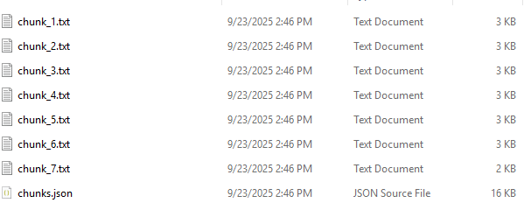
Chunking

Slide 22
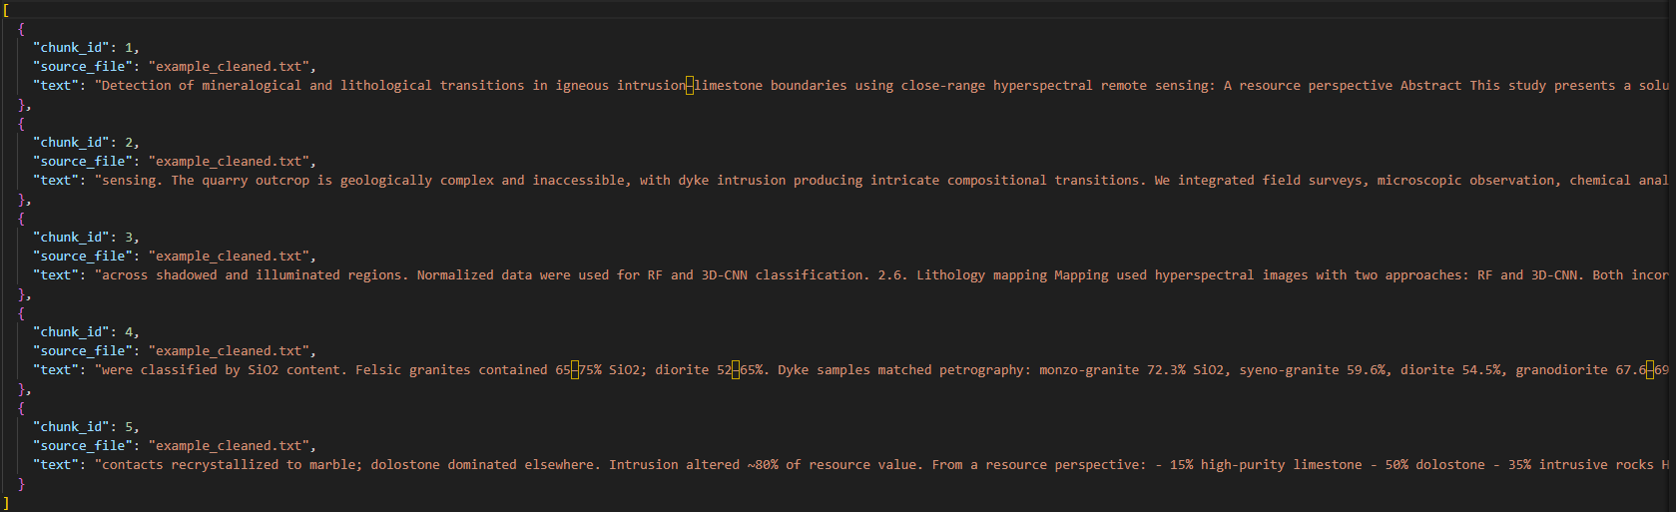
Chunking

Slide 23
Add Metadata
1. Metadata in Fine-Tuning (LoRA, QLoRA, etc.)
If you’re directly fine-tuning an LLM (like LLaMA 8B) with instruction–answer pairs, the model mostly learns from the text itself (the "text" field).
Metadata won’t automatically change how the model learns unless you explicitly include it in the training samples.
2. Metadata in RAG Pipelines
In Retrieval-Augmented Generation (FAISS, Chroma, Pinecone, etc.), metadata is crucial:
You can filter searches by section, date, file, keywords → Metadata directly improves retrieval quality.
3. Metadata in Evaluation / Debugging
It makes training data traceable (you know which file, section, paragraph each chunk came from).
Easier to debug if something goes wrong (e.g., model hallucination traced back to wrong section).

Slide 24
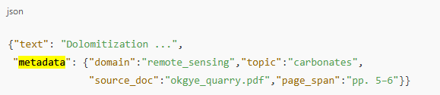
Add Metadata
Why: Metadata lets you filter, audit, sample, and reproduce experiments. It powers RAG indexing and smart curriculum sampling.
Actions: attach fields alongside each chunk (inside the JSON object).
Common keys:
source_doc, page_span (traceability)
domain, topic, subtopic (filtering)
language, reading_level
created_by, created_at (provenance)
content_type (definition/method/results/table/caption)

Slide 25
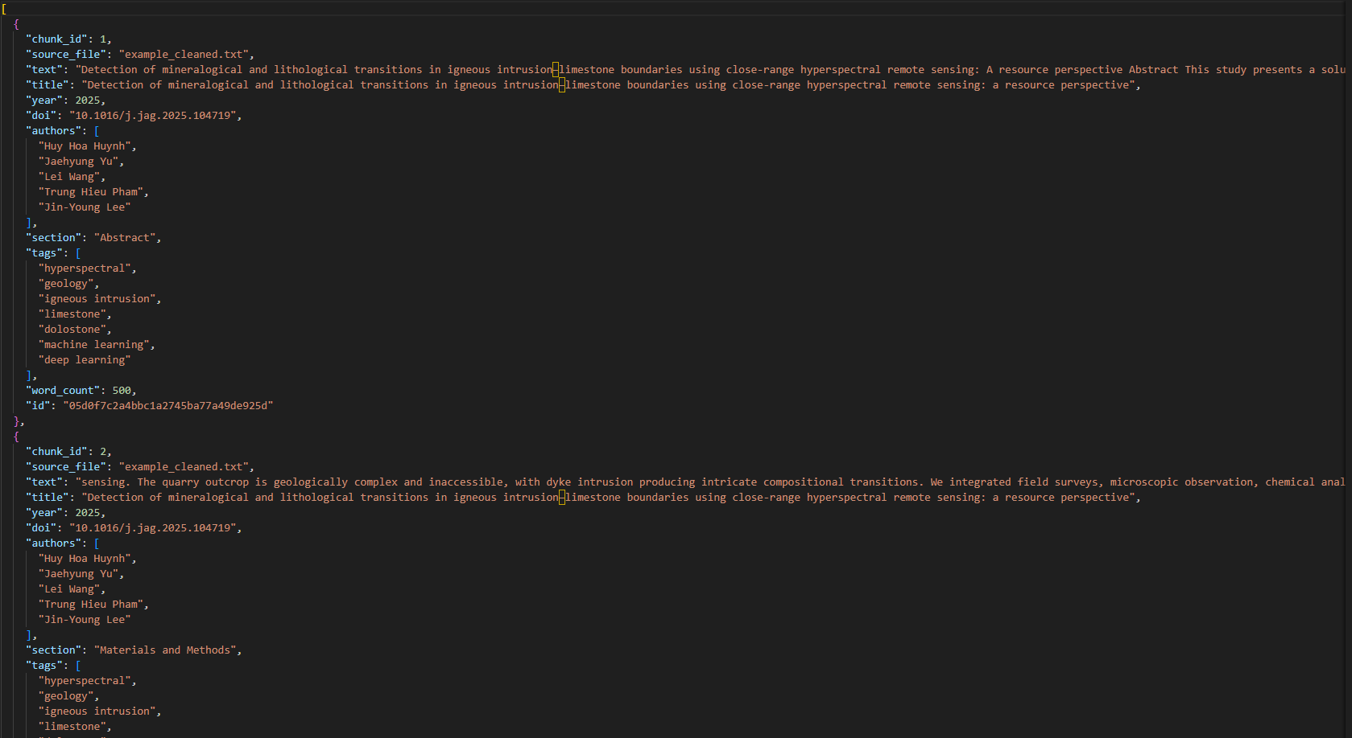

Slide 26
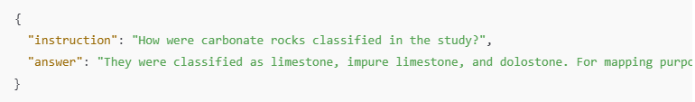
Instruction-Answer (I-A) Format
Why?
Instruction–Answer pairs are the core format for fine-tuning LLMs. They teach the model:
How users ask questions (Instruction).
How the model should respond (Answer).
Step-by-Step
Select a chunk of cleaned text.
Read it and think: What natural question could someone ask about this text?
E.g., “What are the main carbonate rock types in this study?”
Write the instruction (I) as a natural language question or prompt.
Keep it clear and specific.
Write the answer (A) based only on the chunk content.
Keep it concise but informative.
Repeat for multiple chunks to cover different aspects of the paper.

Slide 27
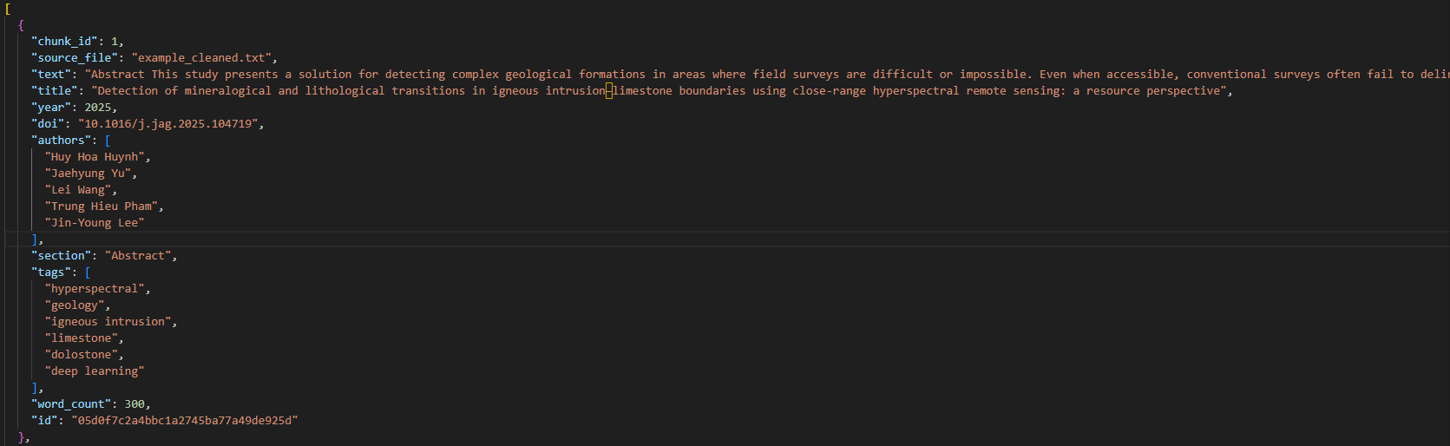
Instruction-Answer (I-A) Format

Slide 28
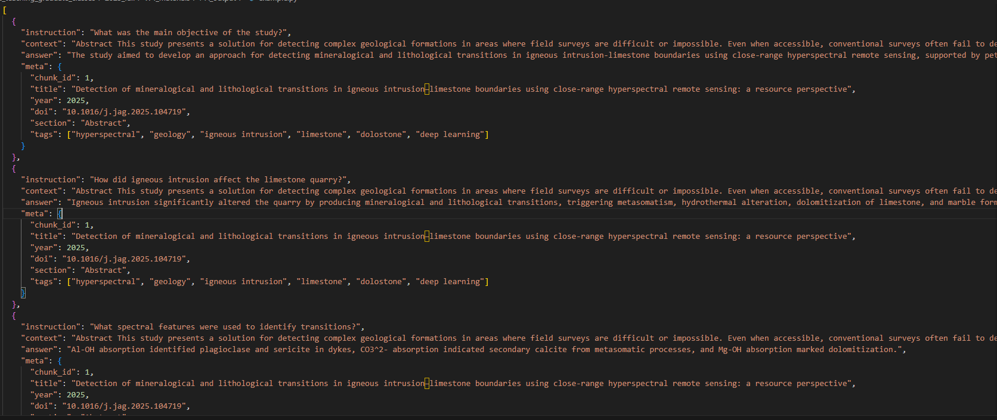
Instruction-Answer (I-A) Format

Slide 29
Assignment
Week 4 Assignment – Cleaning and formatting data

